Slide 1
Causal Relation Extraction
Yuchen Sha
2016.9.21

Slide 2
Outline
Problem Description
Methodology
Evaluation
Problems & Future Work

Slide 3
Problem Description
What kind of causal relation do we want? In which form?
What corpus do we use?
How do we make use of the relation?
Notes:
Subjective concept

Slide 4
Problem Description: causal relation
Causal pairs in WordNet:
modify -> change
improve -> better
break_in -> broken
give -> have
Causal pairs we want:
rain -> umbrella
smoke -> cancer
Causal pairs we want:
Score(smoke, cancer) = ?
Score(Synset(smoke.v.01), Synset(cancer.n.01)) = ?

Slide 5
WordNet
Synset
Hypernym, hyponymy
Lemma
Gloss
Notes:
a large lexical database of English. Nouns, verbs, adjectives and adverbs

Slide 6
Problem Description: corpus
Dataset 1
Bing Snapshot: 68,217,404 candidate causal pairs without original sentences
Dataset 2
Bing Snapshot: 28,820,590 candidate causal pairs with original sentences
Dataset 3
Daily Mail + New York Times: 1,544,413 + 865,918 sentences

Slide 7
Corpus
Dataset 1 | Dataset 2 | Dataset 3
information -> please | lead -> death | injury -> die
like -> please | people -> touch | accident -> die
information -> contact | love -> hope | wound -> die
find -> look | search -> touch | attack -> suffer
people -> touch | disease -> death | action -> die
like -> contact | parent -> child | partly -> partly
add -> add | reward -> arrest | violence -> die
information -> information | remember -> laugh | action -> suffer
add -> text | cause -> girl | complication -> die
contribute -> contribution | offer -> arrest | invasion -> die
Notes:
result

Slide 8
Problem Description: usage
QA problem(Reasoning): COPA Problem
Premise: I knocked on my neighbor’s door. What happened as an effect?
Alternative 1: My neighbor invited me in.
Alternative 2: My neighbor left her house.
WordNet

Slide 9
Methodology
Word pair extraction ------ extraction
WSD using WordNet ------ mapping
Causal strength calculation ------ adjusting
Back to word ------ recovering
Word Level
Sense Level
Word Level
Notes:
Separate/divide

Slide 10
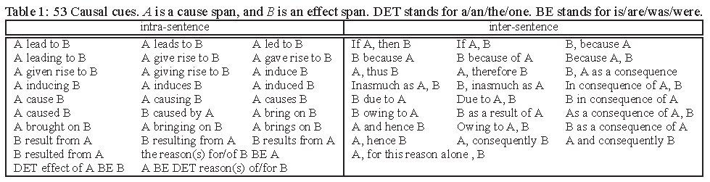
Methodology: extraction
Extract candidate causal pairs from corpus.
Pattern + Rule

Slide 11
Pattern
smoke
be
the
most
preventable
cause
of
cancer
in
the
world
Smoking is the most preventable cause of cancer in the world

Slide 12
Pattern + Rule
Smoking is the most preventable cause of cancer in the world.
nsubj(cause-6, Smoking-1)
cop(cause-6, is-2)
det(cause-6, the-3)
advmod(preventable-5, most-4)
amod(cause-6, preventable-5)
root(ROOT-0, cause-6)
case(cancer-8, of-7)
nmod(cause-6, cancer-8)
case(world-11, in-9)
det(world-11, the-10)
nmod(cancer-8, world-11)
nsubj: nominal subject
A nominal subject is a noun phrase which is the syntactic subject of a clause.
nmod: nominal modifier
The nmod relation is used for nominal modifiers of nouns or clausal predicates.

Slide 13
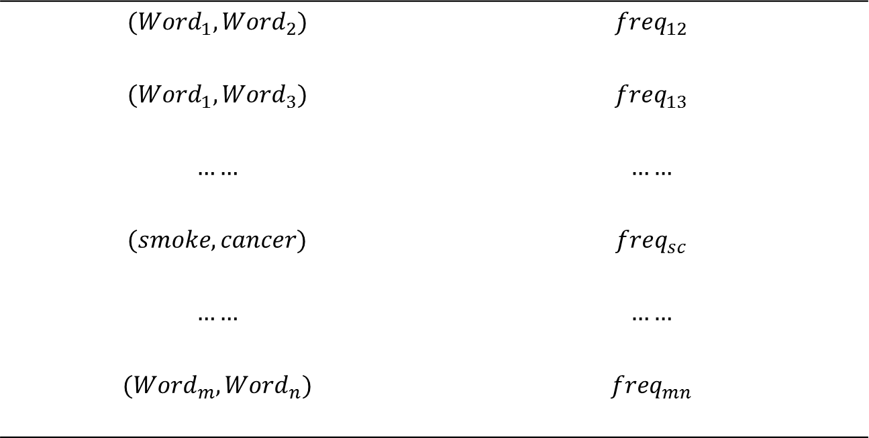
Pattern + Rule
$${(Word}_{1},{Word}_{2})$$ | $${freq}_{12}$$
$${(Word}_{1},{Word}_{3})$$ | $${freq}_{13}$$
$$……$$ | $$……$$
$$(smoke,cancer)$$ | $${freq}_{sc}$$
$$……$$ | $$……$$
$${(Word}_{m},{Word}_{n})$$ | $${freq}_{mn}$$

Slide 14
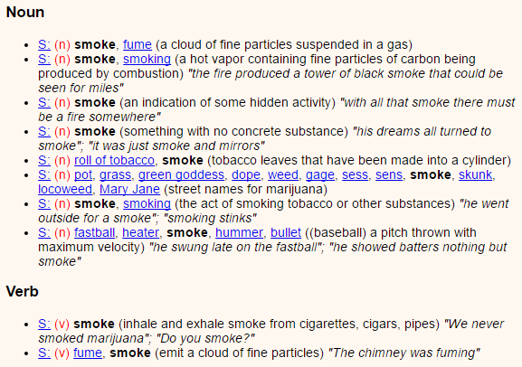
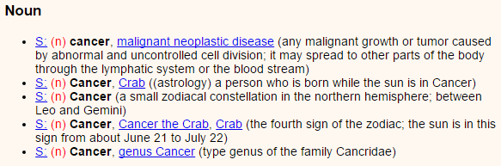

Methodology: mapping
Map word pairs to WordNet and get synset pairs.
$${{freq}_{sc}}/{(10∗5)}$$
{(Synset(smoke.n.01), Synset(cancer.n.01)), (Synset(smoke.n.01), Synset(cancer.n.02)), …, (Synset(smoke.v.02), Synset(cancer.n.04)), (Synset(smoke.v.02), Synset(cancer.n.05))}

Slide 15
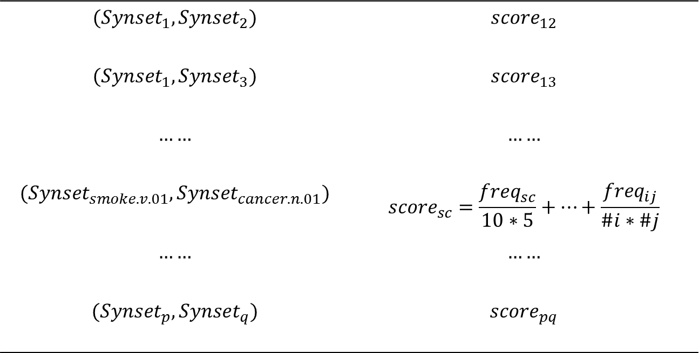
Methodology: mapping
$${(Synset}_{1},{Synset}_{2})$$ | $${score}_{12}$$
$${(Synset}_{1},{Synset}_{3})$$ | $${score}_{13}$$
$$……$$ | $$……$$
$$({Synset}_{smoke.v.01},{Synset}_{cancer.n.01})$$ | $${score}_{sc}=\frac{{freq}_{sc}}{10∗5}+…+\frac{{freq}_{ij}}{\#i∗\#j}$$
$$……$$ | $$……$$
$${(Synset}_{p},{Synset}_{q})$$ | $${score}_{pq}$$

Slide 16










Methodology: adjusting
Adjust sense-level score according to the structure of WordNet
$${score}_{ij}$$
$${Synset}_{i}$$
$${Synset}_{j}$$
${Word}_{1}$, ${Word}_{2}$, ${Word}_{3}$
${Word}_{4}$, ${Word}_{5}$
$${Synset}_{i1}$$
$${Synset}_{i2}$$
$${Synset}_{i3}$$
$${Synset}_{j1}$$
$${Synset}_{j2}$$

Slide 17
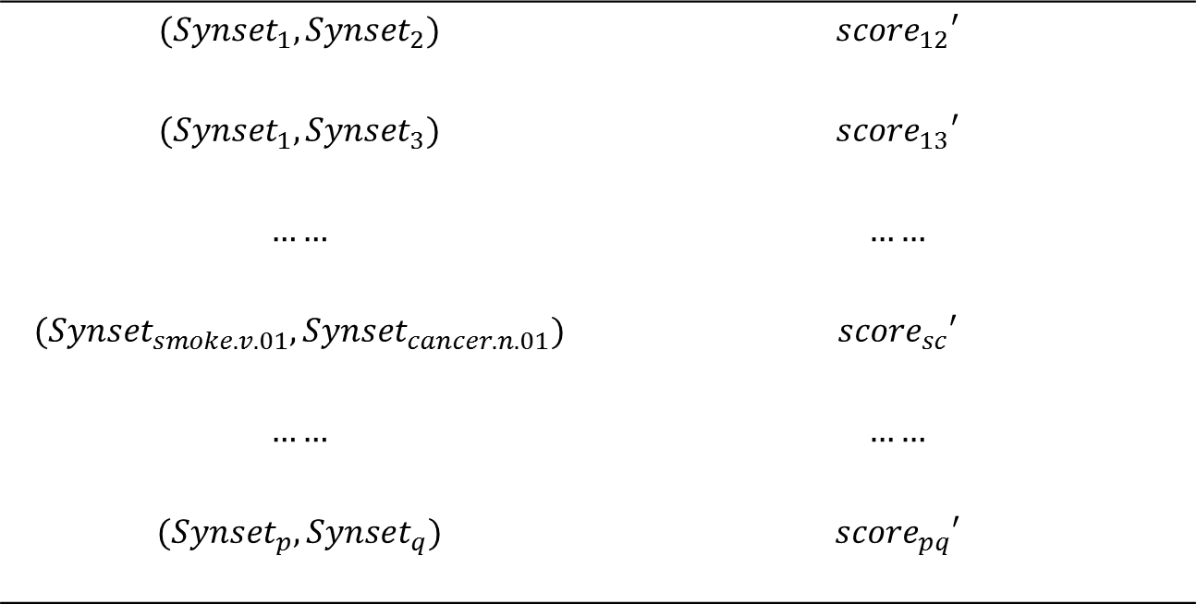
Methodology: adjusting
$${(Synset}_{1},{Synset}_{2})$$ | $${score}_{12}′$$
$${(Synset}_{1},{Synset}_{3})$$ | $${score}_{13}′$$
$$……$$ | $$……$$
$$({Synset}_{smoke.v.01},{Synset}_{cancer.n.01})$$ | $${score}_{sc}′$$
$$……$$ | $$……$$
$${(Synset}_{p},{Synset}_{q})$$ | $${score}_{pq}′$$

Slide 18

Methodology: recovering
Recover from synset pair back to word pair
$${score}_{ij}′$$
$${Synset}_{i}$$
$${Synset}_{j}$$
${Word}_{1}$, ${Word}_{2}$, ${Word}_{3}$
${Word}_{4}$, ${Word}_{5}$
{(${Word}_{1}$, ${Word}_{4}$), (${Word}_{1}$, ${Word}_{5}),…,($ ${Word}_{3}$, ${Word}_{5})\}$

Slide 19
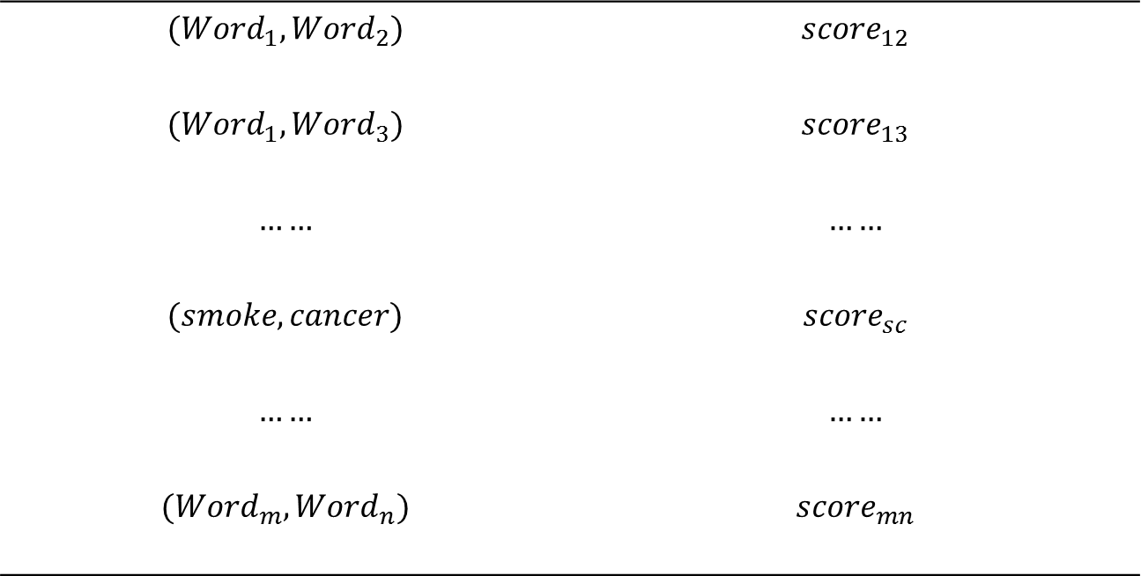
Recovering
$${(Word}_{1},{Word}_{2})$$ | $${score}_{12}$$
$${(Word}_{1},{Word}_{3})$$ | $${score}_{13}$$
$$……$$ | $$……$$
$$(smoke,cancer)$$ | $${score}_{sc}$$
$$……$$ | $$……$$
$${(Word}_{m},{Word}_{n})$$ | $${score}_{mn}$$

Slide 20
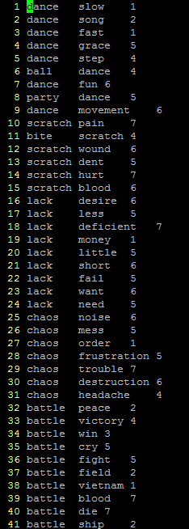
Evaluation
Sense Level
Word Level
COPA Problem
Premise: I knocked on my neighbor’s door. What happened as an effect?
Alternative 1: My neighbor invited me in.
Alternative 2: My neighbor left her house.
Hand Annotated Data
649 positive word pairs
1292 negative word pairs

Slide 21
Problem & Future Work
Extracting: detailed rule, naïve?
Mapping: a lot of synsets, some are rare or useless; how to distribute frequency (equally or with weight?)
Adjusting: prefer to strengthen rather than delete directly
Back: how to recover without losing too many pairs or bring in too many new pairs?

Slide 22
Q & A
Thank you!

